Slide 1

Neural Networks (DNNs and CNNs)
Sharib Ali, Ph.D.
Institute of Biomedical Engineering (IBME)
Big Data Institute (BDI)

Slide 2
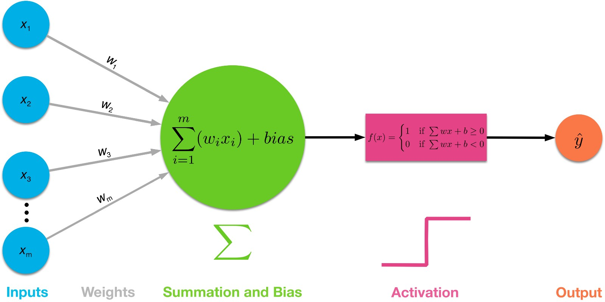

Perceptron
Simple model of a neuron (1958, 1969, 80’s…)
Linear classifier
Finds a hyperplane that separates 2 classes of points (if exists)
Single-layer Perceptron Network
Source: wikipedia
Notes:
Uses heavy-side or unit step function

Slide 3
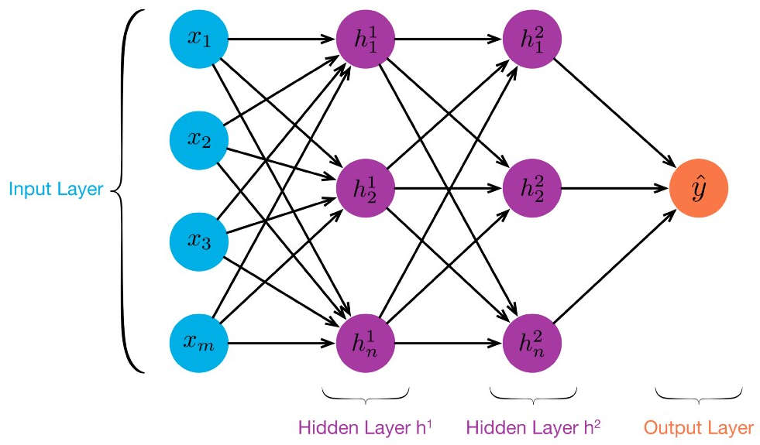
Multi Layer Perceptron
Two main discoveries in 1960s
Backpropagation, a procedure to repeatedly adjust the weights
Hidden Layers, which are neuron nodes stacked in between inputs and outputs, allowing neural networks to learn more complicated features

Slide 4

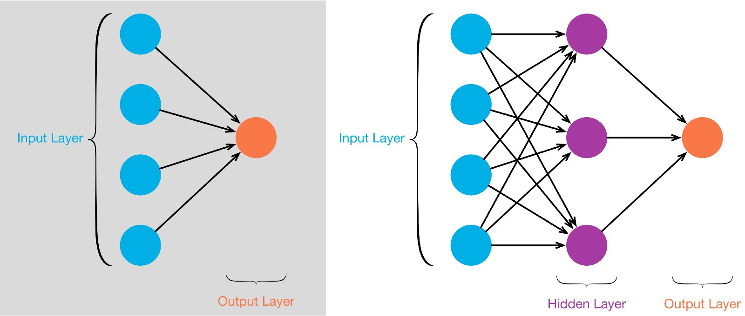
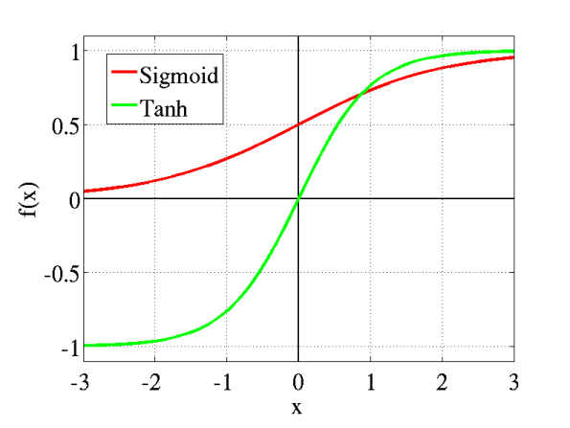
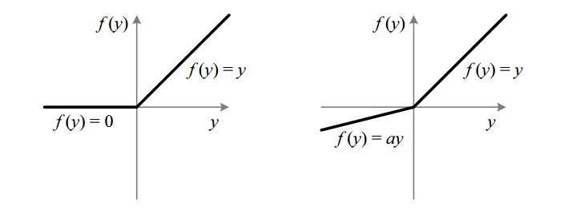
Effects of neurons
Source: wikipedia
Multi-layer Perceptron Network
Activation functions
Demo-NonLinearClassification
Live demo
ReLU
Leaky ReLU

Slide 5
A single neuron
X₁
X₂
X₃
Activations
Notes:
Multi-Layer Perceptron
Fast forward almost two decades to 1986, Geoffrey Hinton, David Rumelhart, and Ronald Williams published a paper “Learning representations by back-propagating errors”, which introduced

Slide 6
2-layer neural network
Forward propagation
.
.
.
Output layer
Hidden layer #1
Hidden layer #2
# parameters:
Sizes:

Slide 7
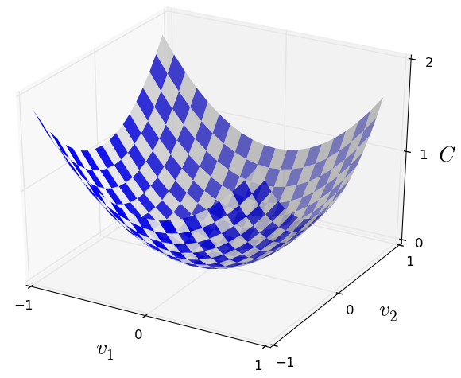
2-layer neural network
Loss function
Cost function
Backpropagation

Slide 8
2-layer neural network
Backward propagation
.
.
.
*Here we assume Stochastic gradient descent.

Slide 9
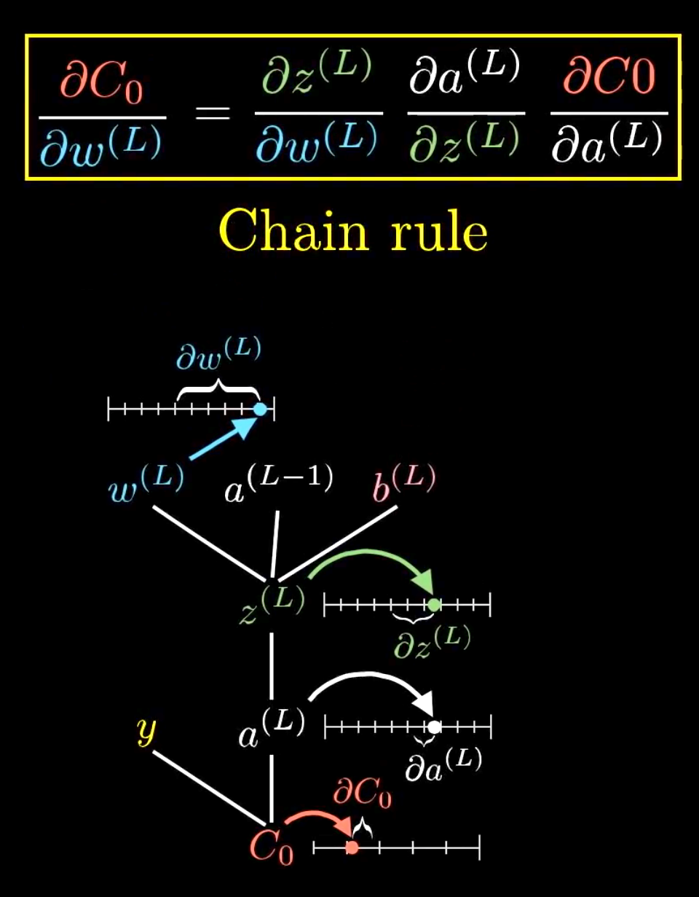
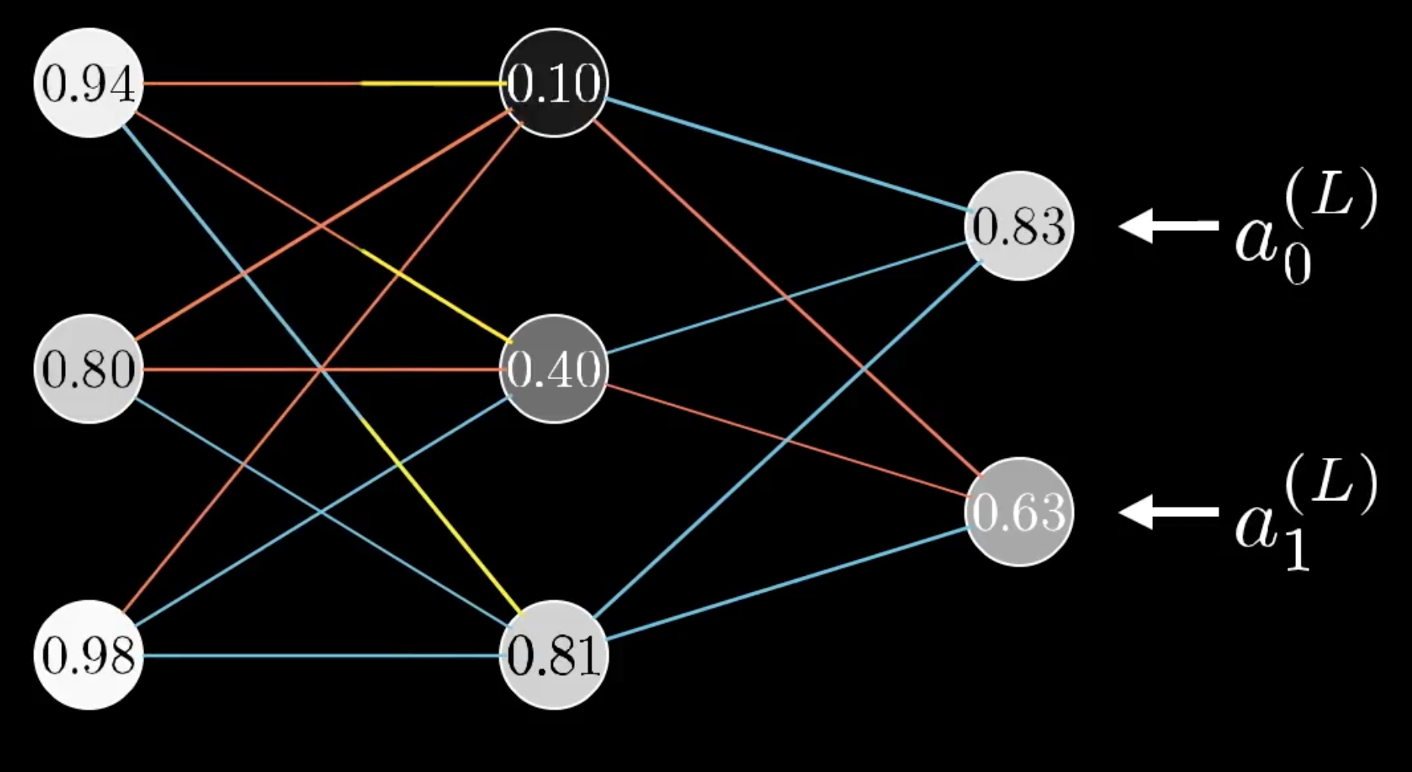
2-layer neural network
Backward propagation and updates
Assuming, gradient descent

Slide 10
2-layer neural network
Backward propagation and updates
Assuming, gradient descent

Slide 11
2-layer neural network
Parameter initialization
In practice, small random values are used to initialize ‘W’ and b is set to 0
Best practice, use Xavier/He initialization
Optimization
Gradient descent, Stochastic gradient descent (SGD) or Adam
Other optimization techniques: momentum, RMSprop, minibatch gradient descent

Slide 12
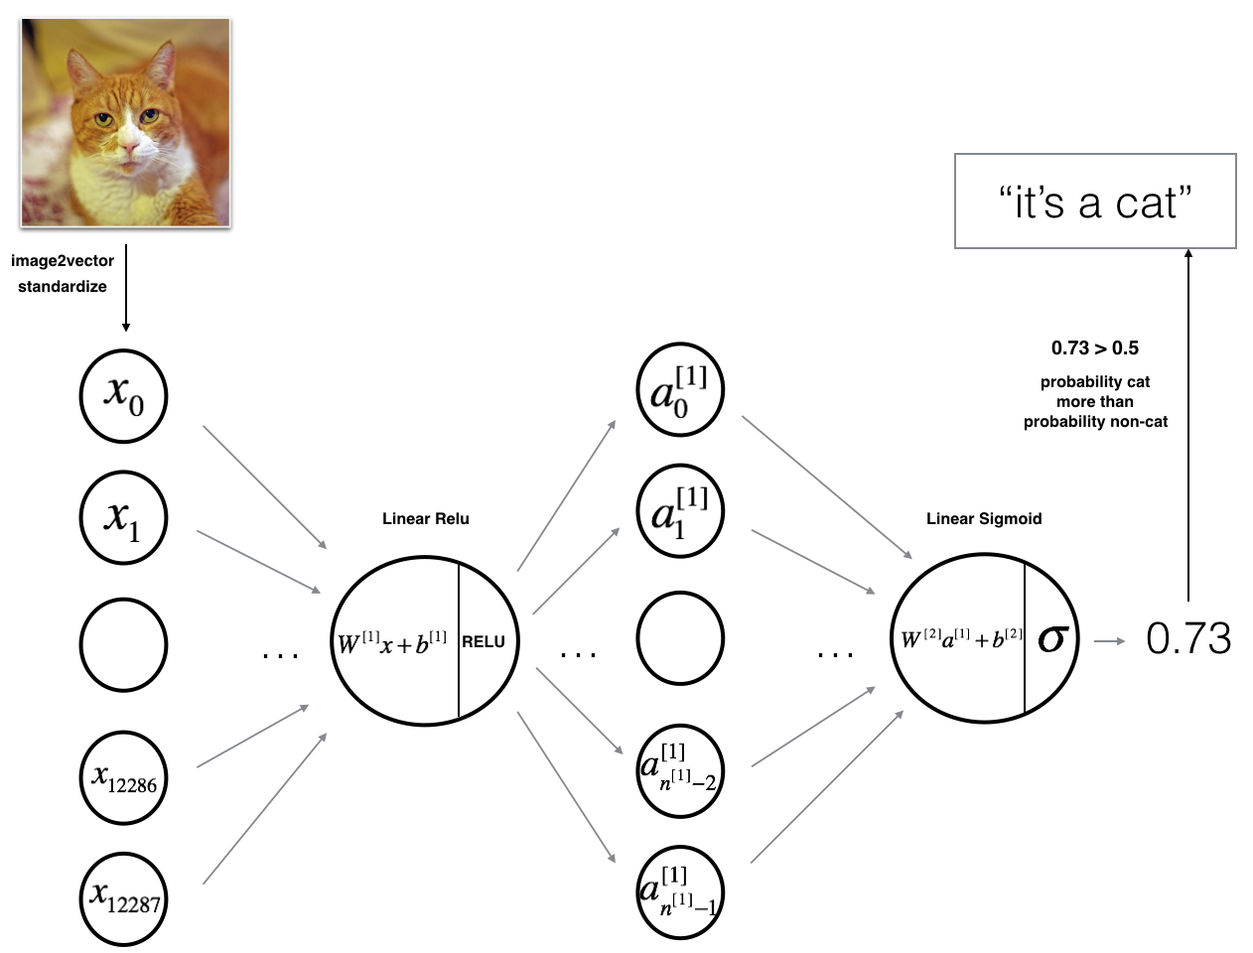
2-layer neural network
Exercises
First create a single neuron and perform logistic regression classification
Design a 2-layer neural network to classify cat vs non-cat image
.
.
.
.
It is a cat!
e.g., 0.8> 0.5 then

Slide 13
Convolutional neural network
Drawbacks of DNN
Number of parameters are large (overfitting, computationally slower)
Does not incorporate local information (like edges, corners in images)
Convolutions in NNs
No. of parameters are reduced
Incorporates local information
Translation invariant
Concept: Use convolution filters to extract feature maps

Slide 14
Brief history: CNN
Gradient-based learning applied to document recognition, LeCun, Bottou, Bengio, Haffner, 1998
Notes:
Applications
Ink removal
Artefact detection
Add slides for CNN

Slide 15

Brief history: CNN (Revolutionary)
ImageNet classification with Deep Convolutional Neural Networks,
Krizhevsky, Sutskever, Hinton, 2012
Notes:
Applications
Ink removal
Artefact detection
Add slides for CNN

Slide 16
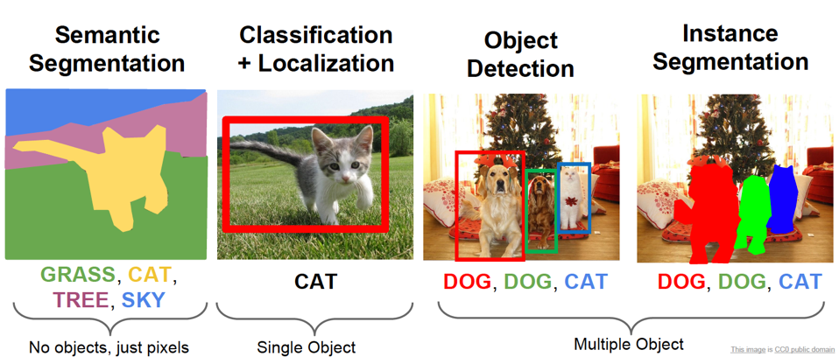
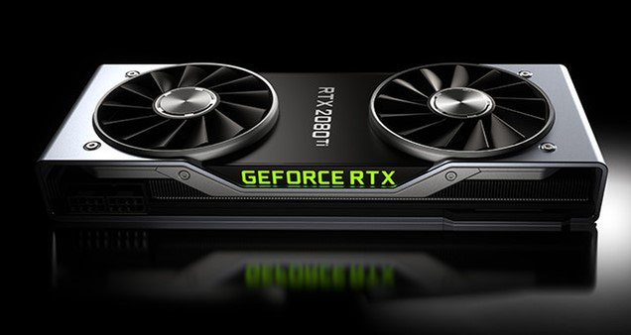
Today: CNN
It’s everywhere: from image classification and localization to image retrieval; from object detection to image segmentation; image generation; and many more…
This has to do a lot with
advanced GPUs
Notes:
Applications
Ink removal
Artefact detection
Add slides for CNN

Slide 17
CNN
Recall, fully connected layer
Flattened input
Activation o/p
64x64x3=12288
Notes:
Applications
Ink removal
Artefact detection
Add slides for CNN

Slide 18
CNN
Activation maps
filter
Convolve the filter with the images, that is, slide your filter over the images spatially
No. of parameters= #no. of filters * (27 + 1(bias)
Notes:
Applications
Ink removal
Artefact detection
Add slides for CNN

Slide 19
CNN: Model?
Suppose you want to convolve above image with 5x5x3 filters and you want to have 6-10-10 maps. Compute: a) No. of parameters and b) dimension of your activation maps
Notes:
Applications
Ink removal
Artefact detection
Add slides for CNN

Slide 20
CNN: What do they learn?
Visualization of VGG-16 by Lane Mcintosh. [Zeiler and Fergus 2013]
Notes:
Applications
Ink removal
Artefact detection
Add slides for CNN

Slide 21
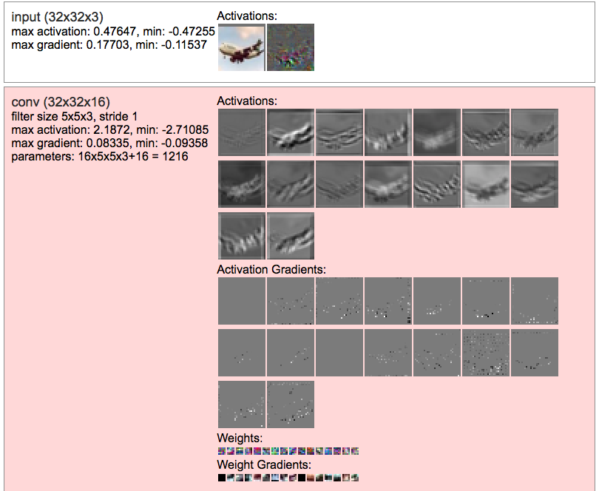
CNN: What do they learn?
Play here: cnnsWithCifar10:onlineDemo_karpathy
Notes:
Applications
Ink removal
Artefact detection
Add slides for CNN

Slide 22
CNN: Pooling
Note: Each channel in activation map is down-sampled independently
Notes:
Applications
Ink removal
Artefact detection
Add slides for CNN

Slide 23
CNN: Max pooling
Concept
Take maximum value in a given filter and stride e.g. 2x2 filter with stride 1
Try with 2x2 filter with stride 2 and stride 3
2 | 3 | 5 | 7
8 | 2 | 9 | 3
3 | 7 | 8 | 1
0 | 9 | 8 | 2
8 | 9 | 9
8 | 9 | 9
9 | 9 | 8
Notes:
Applications
Ink removal
Artefact detection
Add slides for CNN

Slide 24
CNN: FC layer
Last layer always contains neurons that connect to the entire input volume
Common practice is to add several pooling layers before the last layer
Typical architecture is:
[(Conv-RELU)..(Conv-RELU)*POOLING]*--(FC-RELU)*K, Softmax
But, not only limited to above
Notes:
Applications
Ink removal
Artefact detection
Add slides for CNN

Slide 25
CNN: Dropout
Concept
Randomly knocking out units in your neural network
That is, using smaller network
So, can’t rely on any one feature so the weights get spread out
This you can do it at a particular layer/vary your dropout differently at different layers
This effect in regularization and avoid from over-fitting
Notes:
Similar to L2 regularization

Slide 26
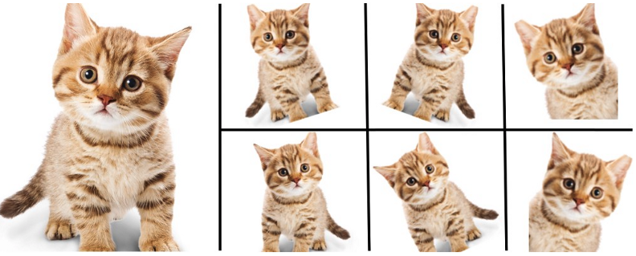
CNN: Data augmentation
Concept
Increase your training data by performing transformations: e.g., color transformation, scaling, rotations, translations, shear etc
You can do this on fly during your training (https://keras.io/preprocessing/image/)
This allows regularization as well and you might get better accuracy
Image source: https://medium.com/nanonets
Notes:
Similar to L2 regularization

Slide 27

Keras
Widely used (https://keras.io)
Easy to construct your network
Allows easy and fast prototyping
Runs both on CPU and GPU
High-level neural network API and tensorflow backend

Slide 28
Keras: How easy?
Design your model
Compile your model
Fit your model

Slide 29

Tensorflow and PyTorch
Worth learning for development
Both allows you to develop each component of your network
Tensorflow is better for deployment especially for real-time applications
We will show you how to get started with tensorflow as well

Slide 30
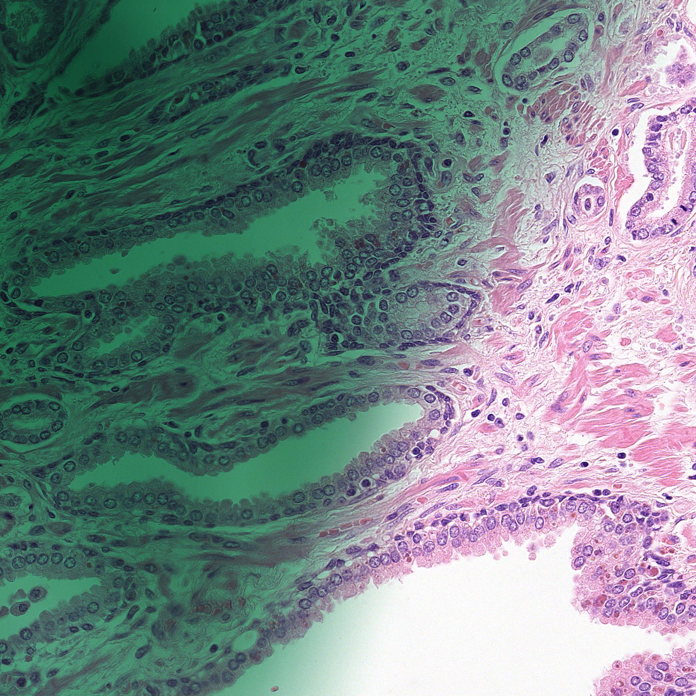
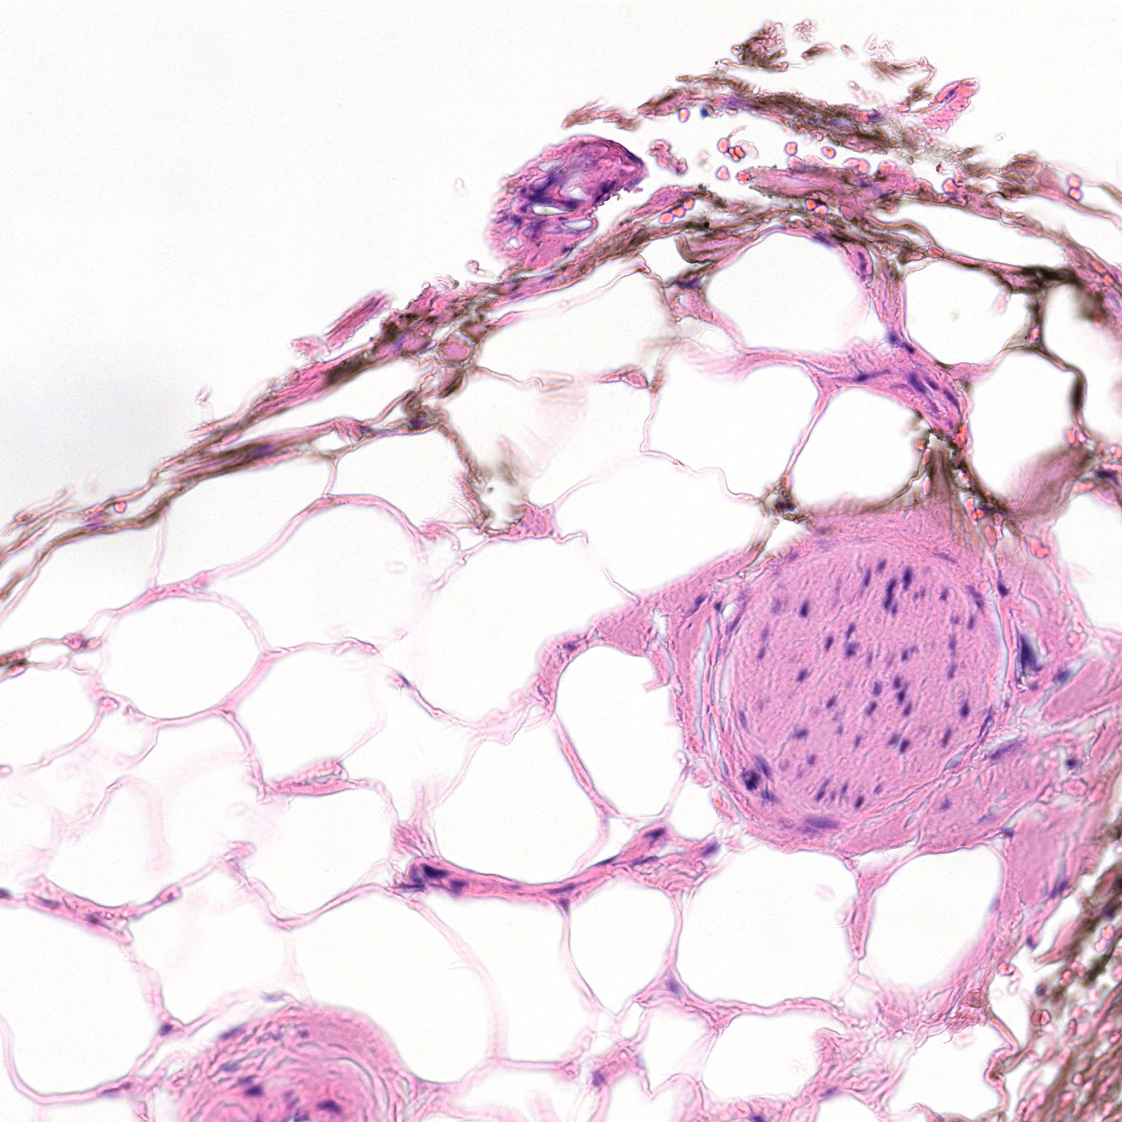
Example application
Ink Removal in histopathology data
Ink:1
no-Ink:0

Slide 31
Recap
Perceptron
Deep neural networks
Convolutional neural networks
Applications
Cat vs non-cat
MNIST digit dataset (classify 10 different digits)
Binary classification of marker ink vs non-ink in histopathology data

Slide 32
Practical
Exercises
Now, lets look at L-layer neuron network and see how this improves test accuracy
Lets implement using Keras and TensorFlow libraries
Lets discover the limitation of small size data and see advantage of large size data
Datasets can be downloaded here:
https://s3.amazonaws.com/teachingv3.0/datasets.zip
You can also try ink-no-ink classification (complimentary)
https://s3.amazonaws.com/teachingv3.0/ink_removal_data.zip

Slide 33
Practical
Project: You will try to find publicly available medical dataset for multi-class or binary classification or use any one of below:
a) Grand-challenge datasets
https://grand-challenge.org/challenges/
https://ead2019.grand-challenge.org (multi-class problem and bounding box detection)
b) Kaggle datasets (you can even win cash prizes here!!!)
https://www.kaggle.com/c/histopathologic-cancer-detection
https://www.kaggle.com/c/diabetic-retinopathy-detection/data
https://www.kaggle.com/c/rsna-pneumonia-detection-challenge (multi-class problem and bounding box detection)
c) Malaria dataset released by Dr. Stefan Jaeger (https://ceb.nlm.nih.gov/repositories/malaria-datasets/). We have provided you data which contains downscaled 64x64x3 h5 compressed 27,558 images. Tasks are detailed in the provided ipython notebook.
*Note: Beware of computation power that you might need to work with these data. For learning, you will scale down all data that you intend to use.

Slide 34
Good reads!
“Hands-On Machine Learning with Scikit-Learn and TensorFlow” by Aurélien Géron
“Deep learning” by Ian Goodfellow, Yoshua Bengio and Aaron Courville
You can look more lists here:
https://www.bonkersabouttech.com/ai/best-deep-learning-books/494

